Slide 1
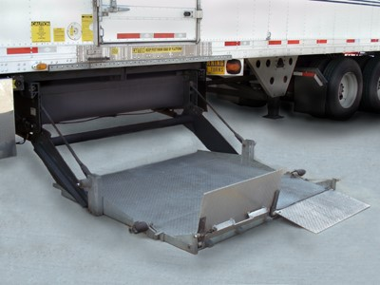
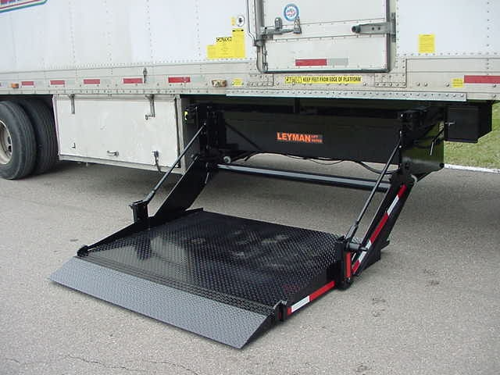
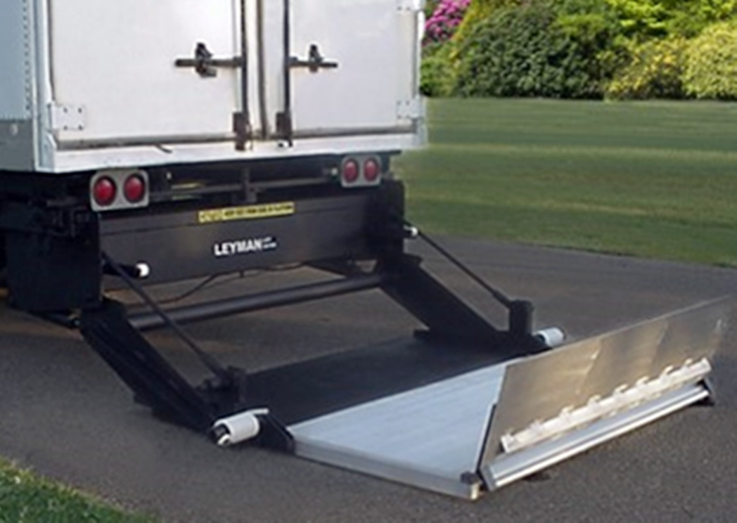
TLS, LPS, LPR Troubleshooting Guide
LPS
TLS
LPR

Slide 2
TLS, LPS, LPR Troubleshooting Guide
Table on Contents
Page 3 Electrics
Page 4-6 Grounding
Page 5-11 Gate does not run up, in, out, but goes down. Motor not running
Page 12-15 Gate runs up, in, down but not out.
Page 16-19 Gate runs up, out, down but not in.
Page 20-21 Gate runs in, out, up but not up.
Page 22-25 Gate runs in, out, up but not down.
Page 26-28 Gate does not run Up, Down, In, or Out Motor not running
Page 29 Gate in & out moves side to side when running in & out.
Page 30-35 Maintenance Minder² Faults.

Slide 3
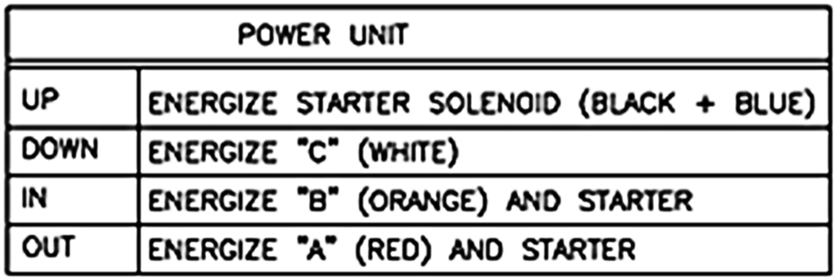
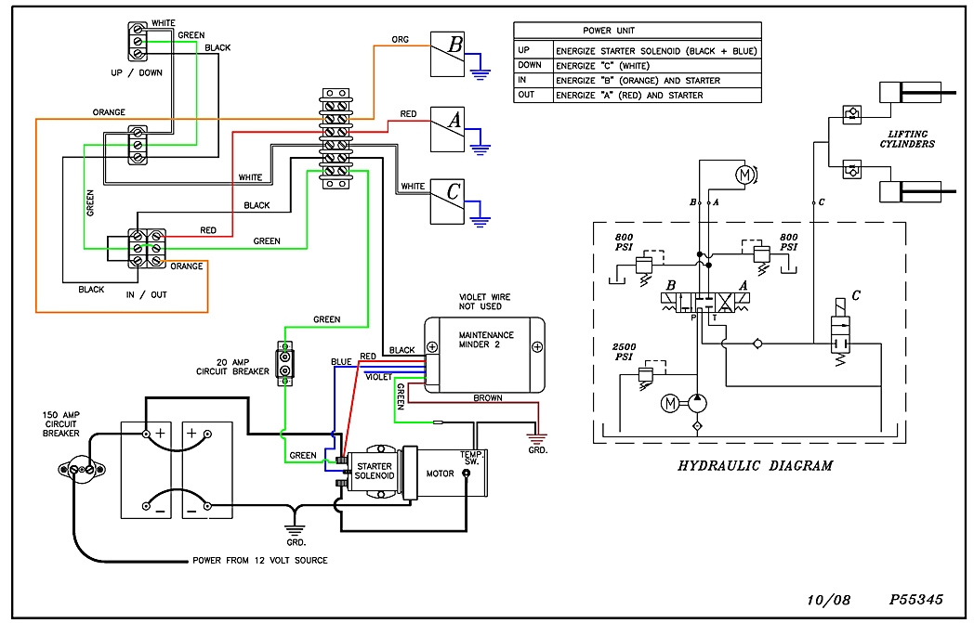
Laminated on the inside of the power unit door is a wire and hydraulic schematic. Also there is a box on the schematic that lets you know which valve and if motor runs. Use this to help diagnose problems.
Use this box whenever you are
troubleshooting most problems
as it tells you what valves and if
the motor is running depending
on what operation you are
preforming.

Slide 4
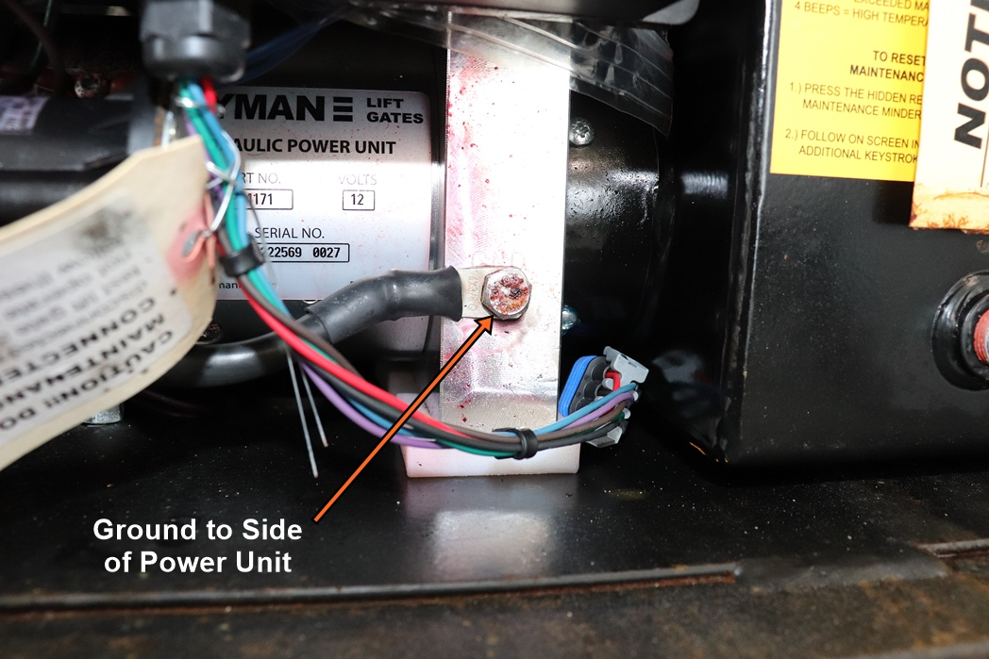
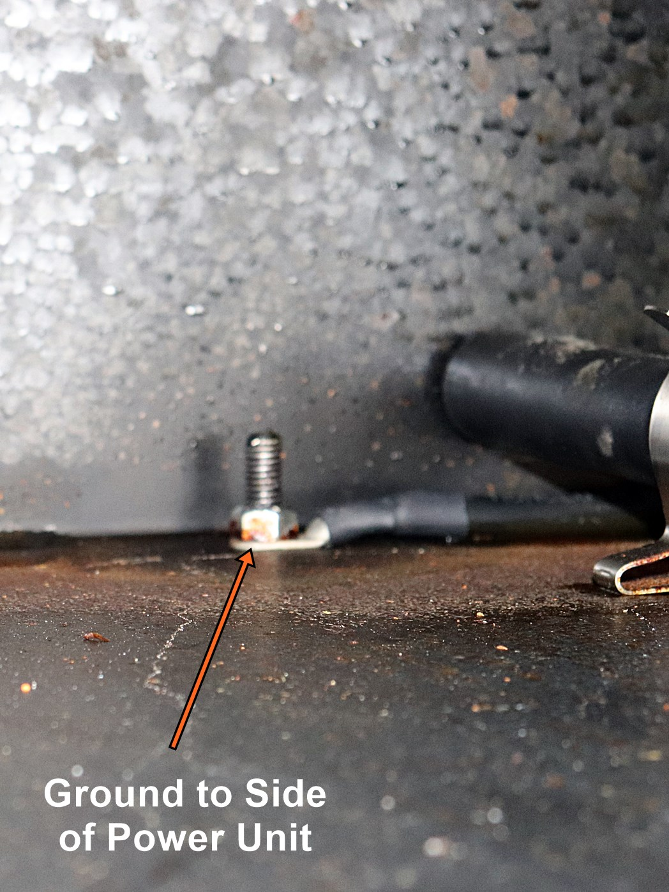
NOTE: Whenever troubleshooting a gate first make sure the batteries are fully charged, all connections are clean, tight, and all ground are secure

Slide 5
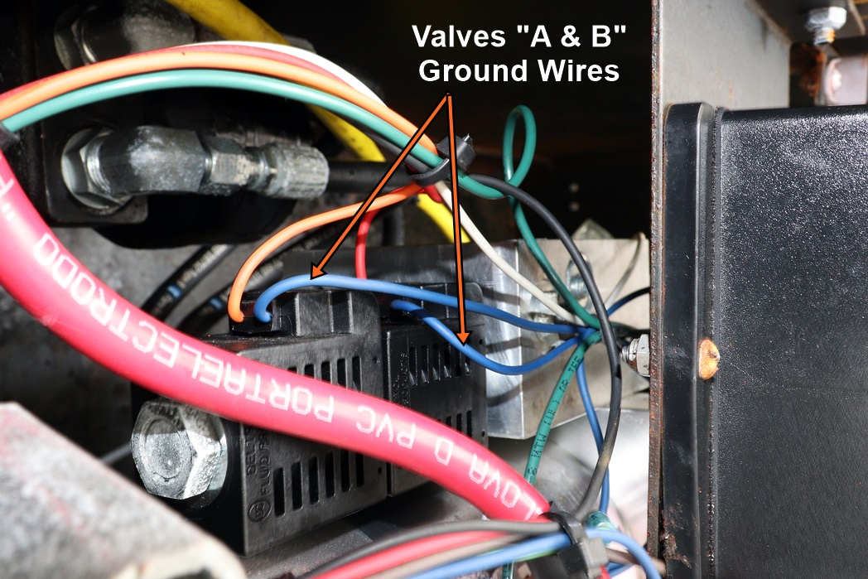
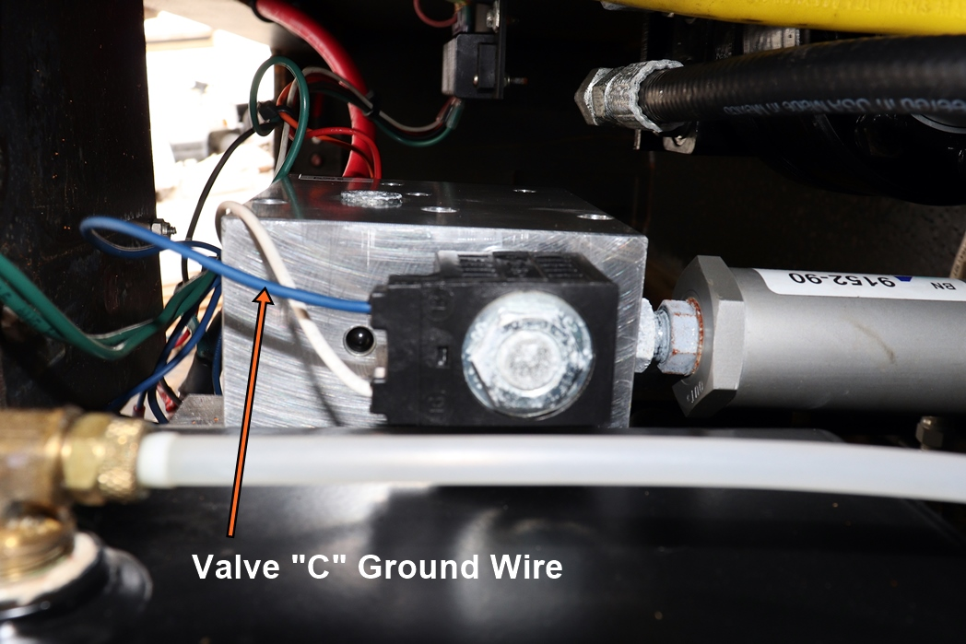
NOTE: Whenever troubleshooting a gate first make sure the batteries are fully charged, all connections are clean, tight, and all ground are secure

Slide 6
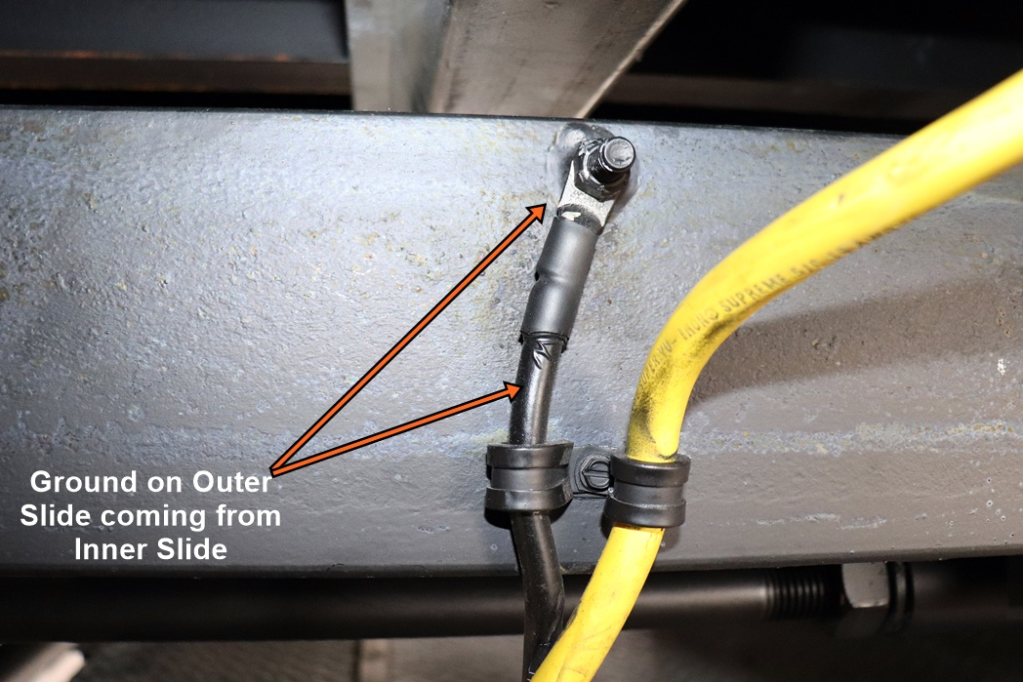
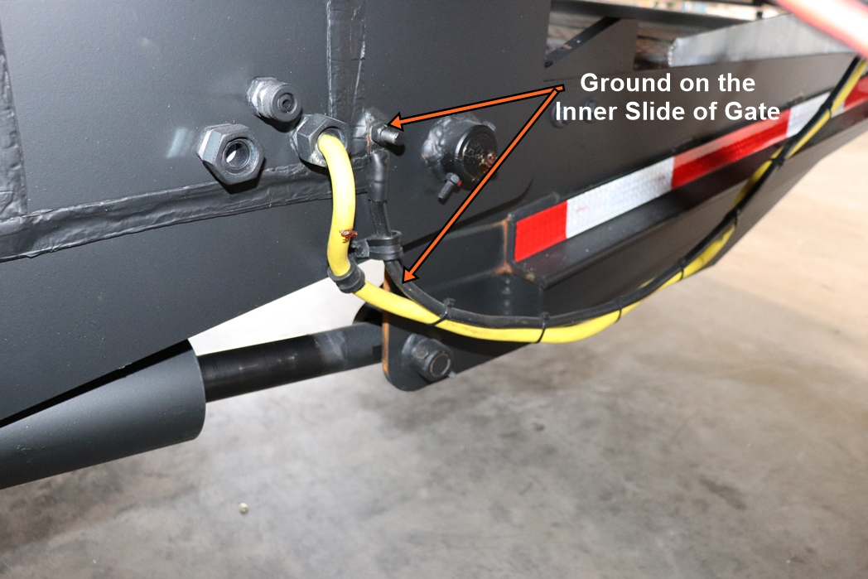
NOTE: Whenever troubleshooting a gate first make sure the batteries are fully charged, all connections are clean, tight, and all ground are secure

Slide 7
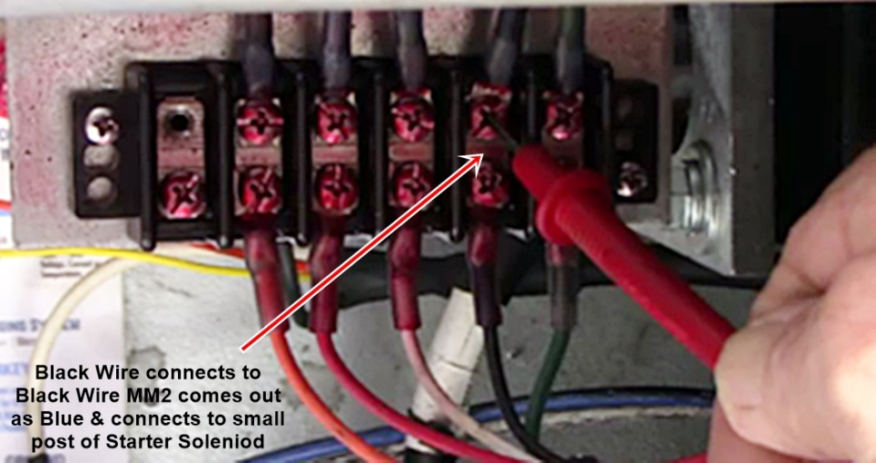
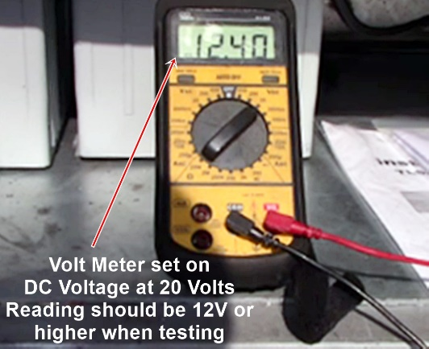
Symptom: Gate does not run up, in, out, but goes down. Motor not running
1). Check voltage at the terminal strip on the black wire for 12V by trying to run the gate up, in or out. If you have voltage at the black wire at the terminal strip, then switches and yellow wiring Harness from terminal strip to In & out box are good.

Slide 8
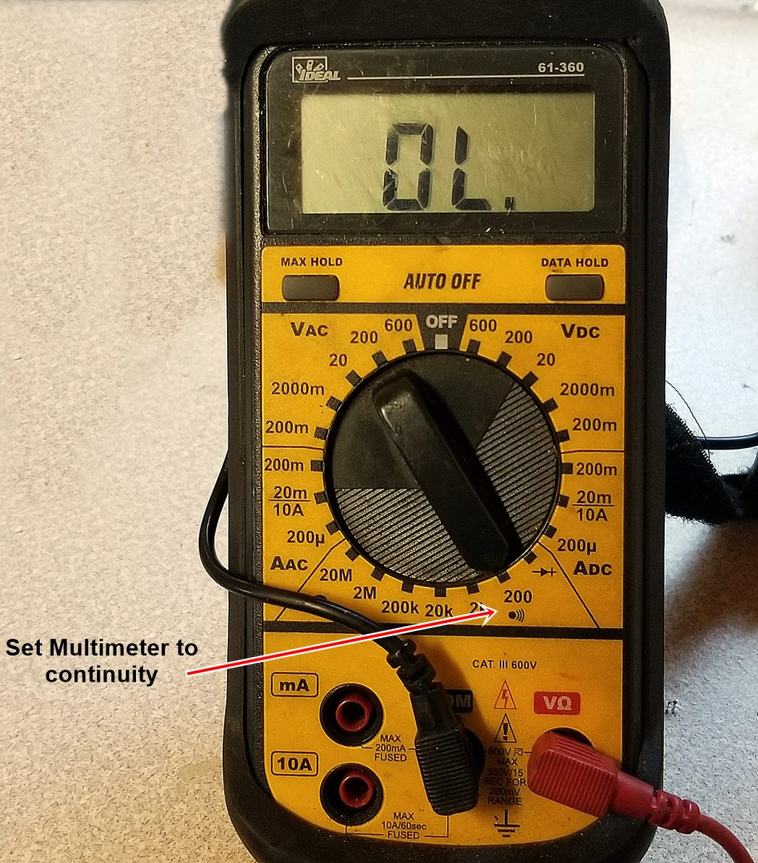
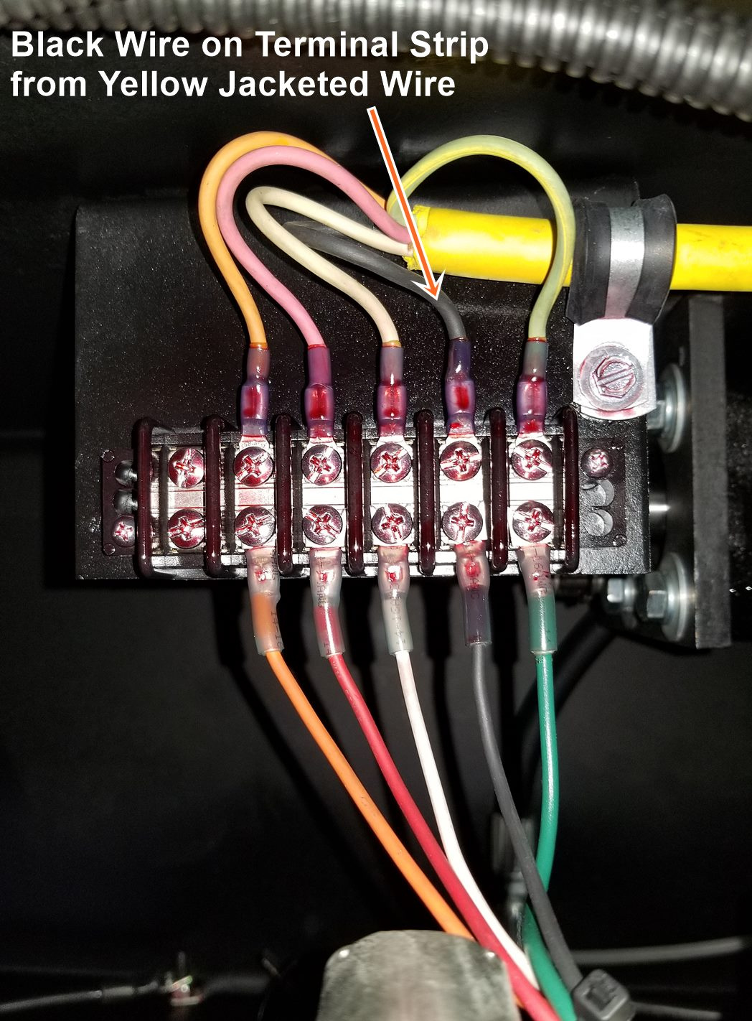
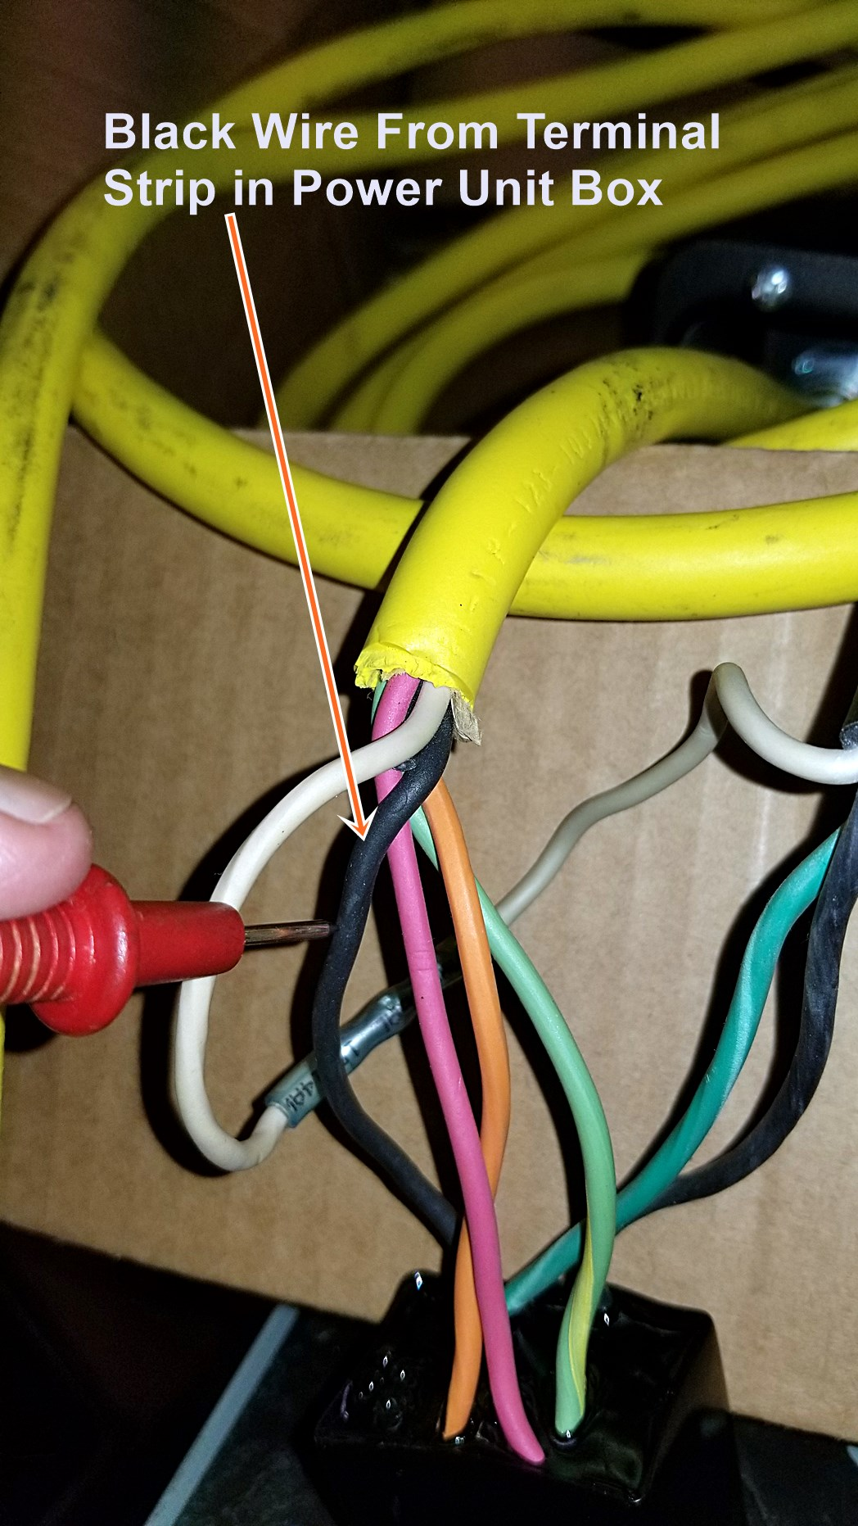
Symptom: Gate does not run up, in, out, but goes down. Motor not running
2). If there is no voltage at the black wire, check continuity from the black wire on the terminal strip to the black wire in the In & Out Switch Box on the yellow wiring harness. If you have no continuity on the black wire change the yellow cable wiring harness.

Slide 9
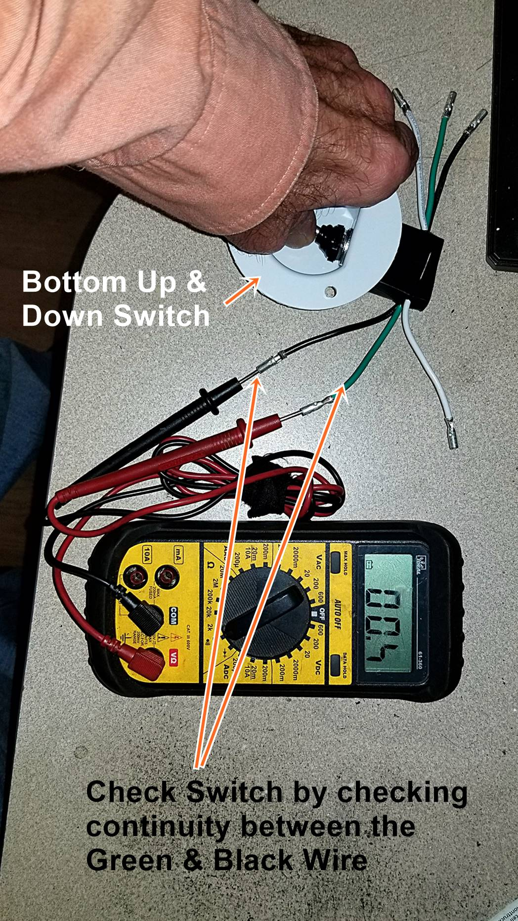
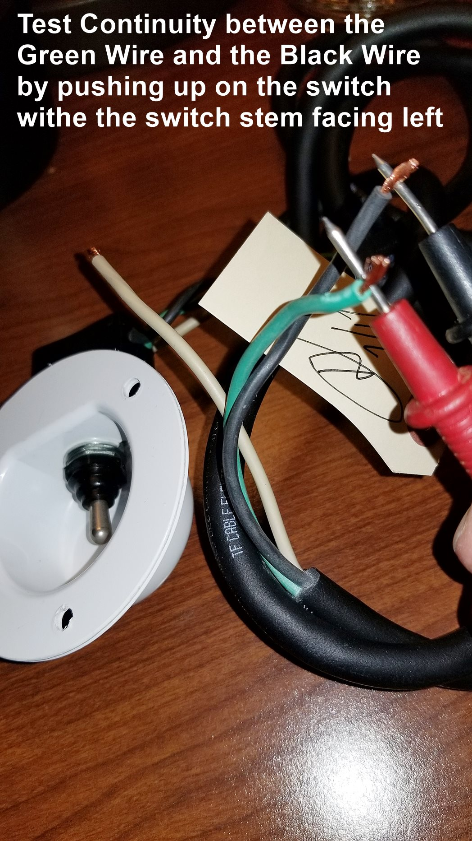
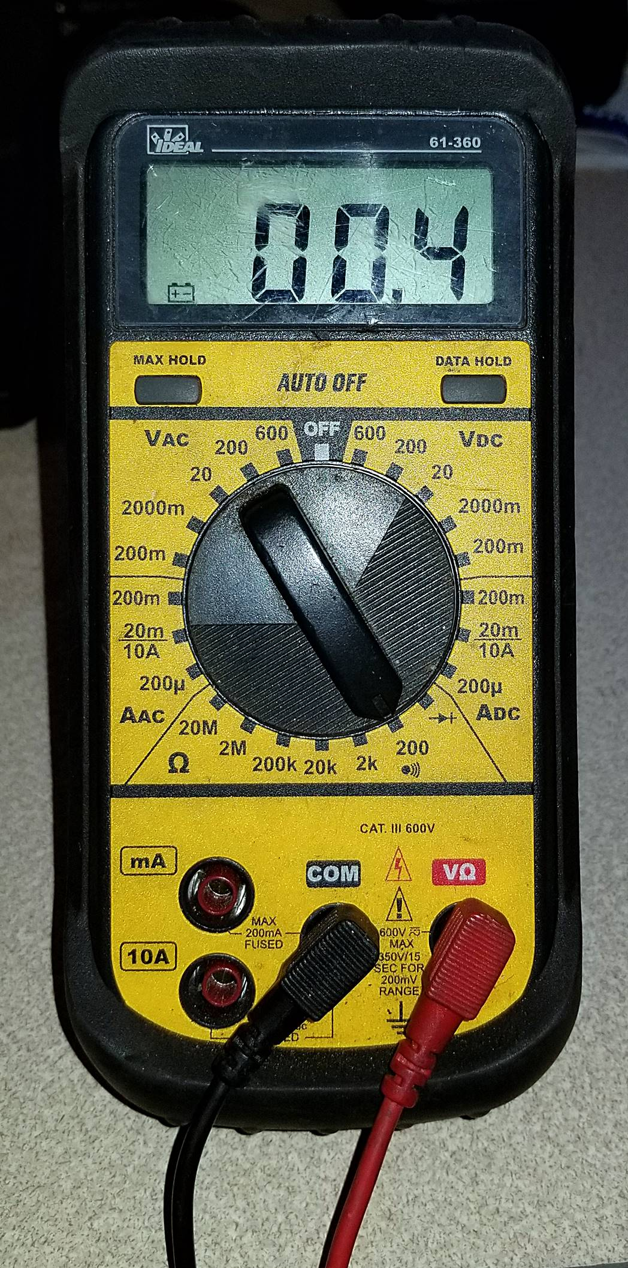
Symptom: Gate does not run up, in, out, but goes down. Motor not running
3). If you have continuity from the black wire on the terminal strip to the black wire in the In & Out Switch Box Check Switches for continuity, If you have no continuity when operating the switch, the switch is bad

Slide 10
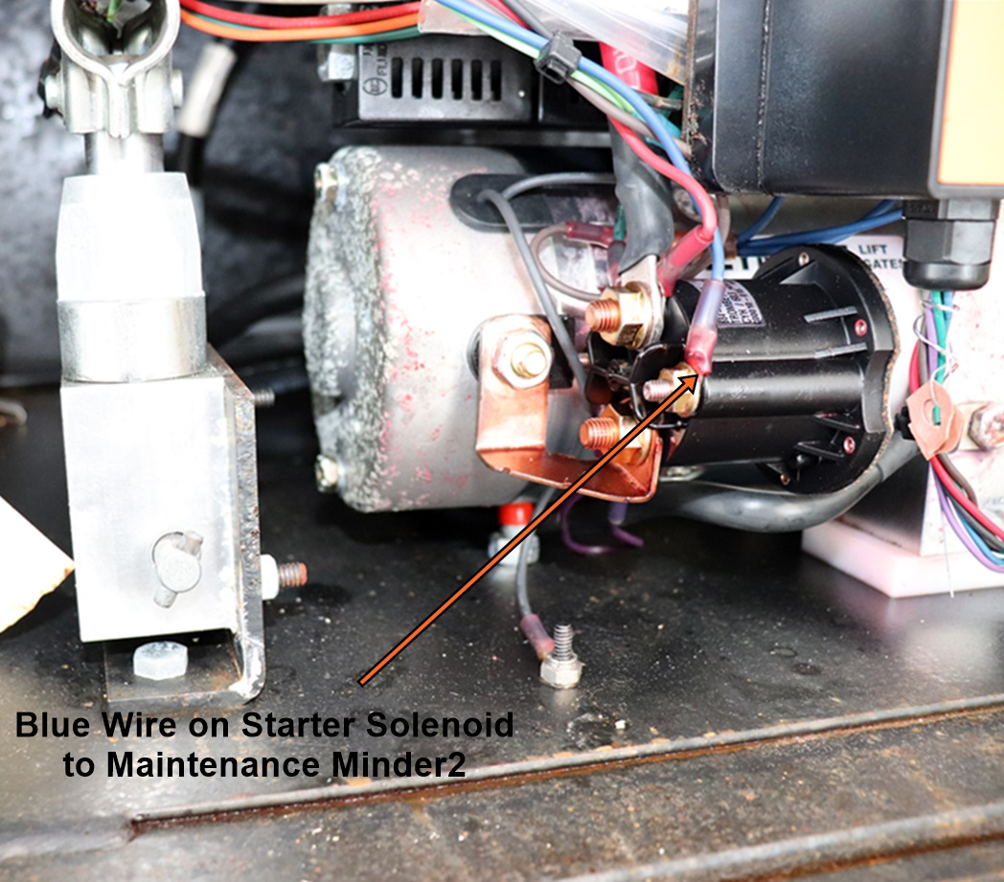
Symptom: Gate does not run up, in, out, but goes down. Motor not running
4). If you have voltage at the black wire at the terminal strip, then switches and yellow wire from terminal strip to In & out box are good. Check Voltage at the Blue wire on the small post of the starter solenoid.

Slide 11
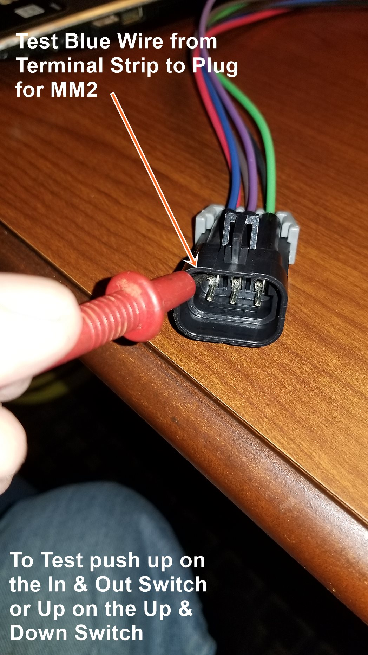
Symptom: Gate does not run up, in, out, but goes down. Motor not running
5). If you have no voltage at the blue wire on the small post of the starter solenoid, then the MM2 could be bad. Check the Voltage at the duetsch connection for the MM2 coming from Terminal Strip. If you have no voltage the wire on the pigtail is bad if you do then the MM2 is bad.

Slide 12
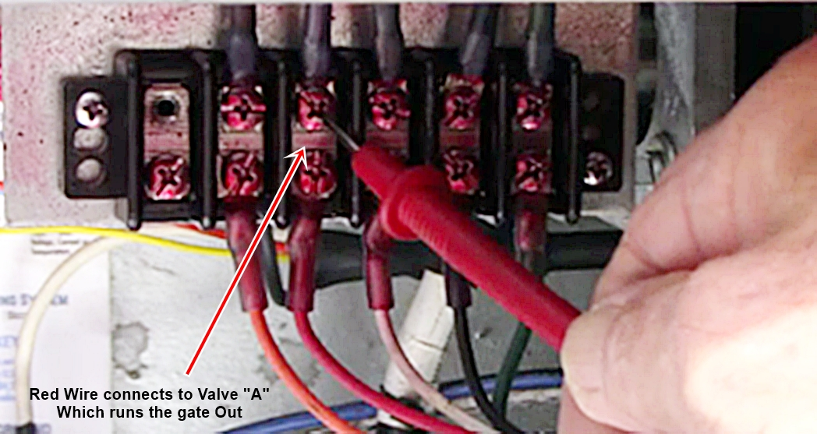
Symptom: Gate runs up, in, down but not out.
1). Check for 12V at the red wire on the terminal strip. If you have 12V check coil on double stem.

Slide 13
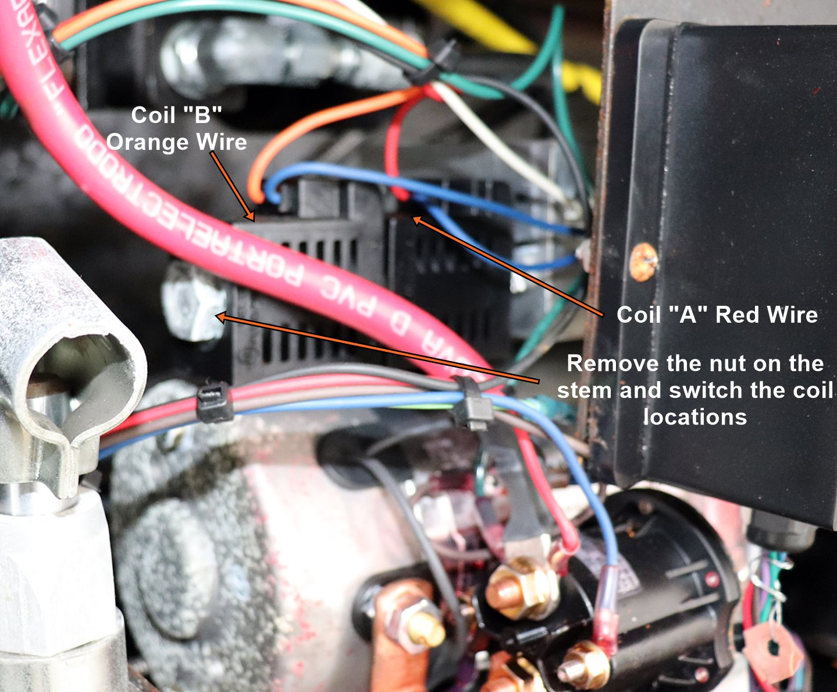
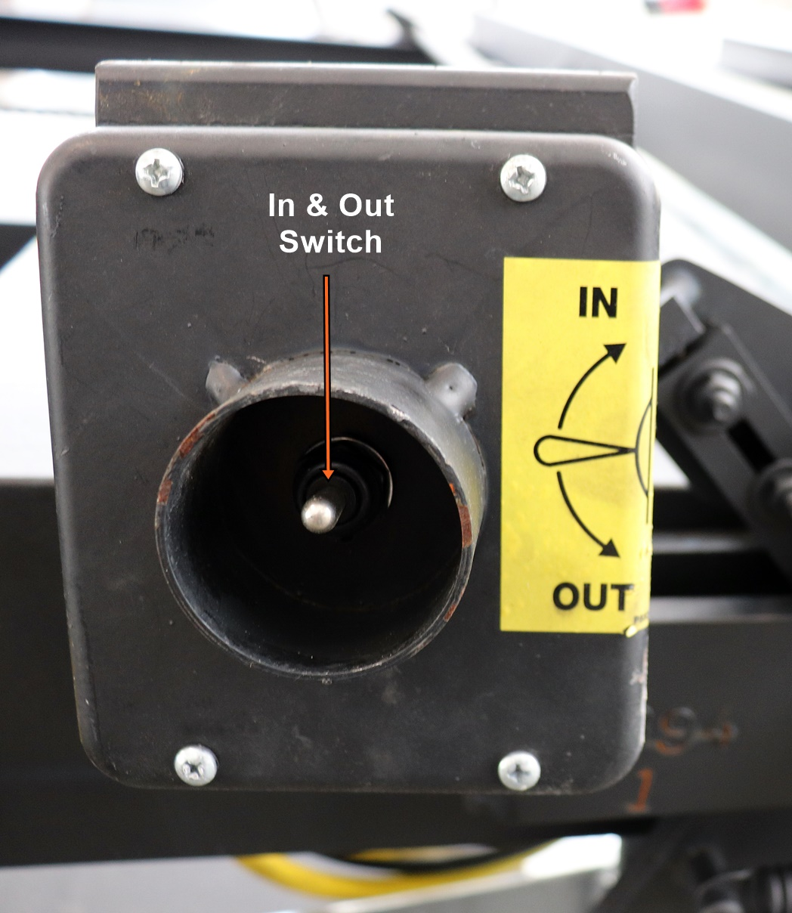
Symptom: Gate runs up, in, down but not out.
2). If you have 12V check coil on double stem. Easy way to check the coil is to swap coil “A” & “B”. Push up on the In & Out Switch if the gate runs out then the coil is bad. If the gate doesn’t move and you hit down on the In & Out Switch and it runs in then the Stem is bad.

Slide 14
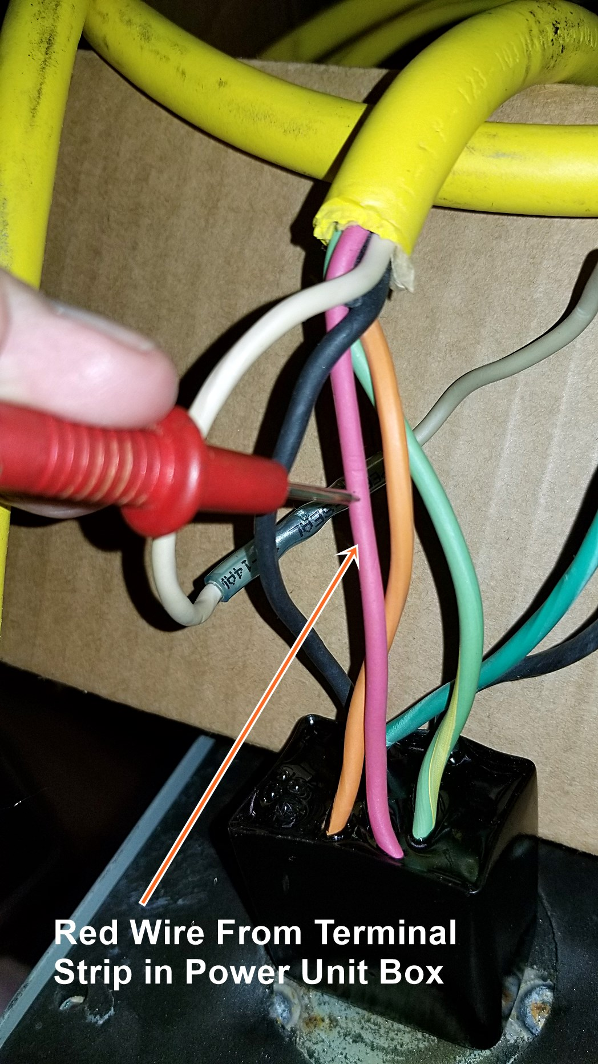
Symptom: Gate runs up, in, down but not out.
3). Check for 12V at the red wire on the terminal strip. If you don’t have 12V at the red wire on the terminal strip then do a continuity check on the red wire from the terminal strip to the In and Out Switch in the In & Out Switch Box. If no Continuity change yellow wiring harness.

Slide 15
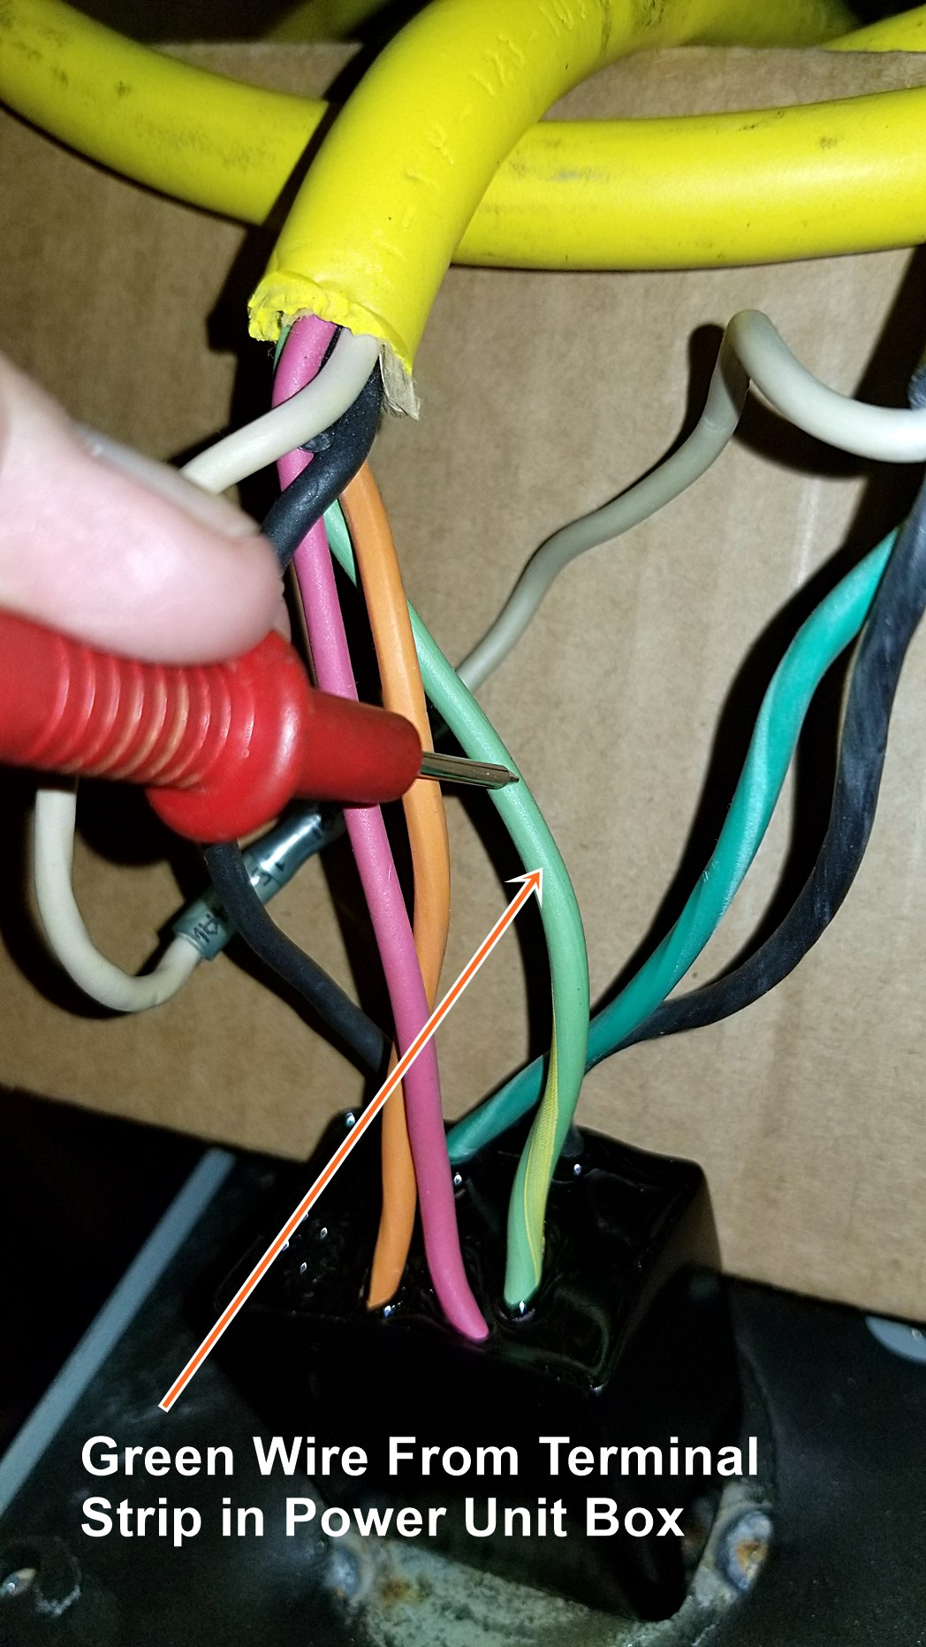
Symptom: Gate runs up, in, down but not out.
4). If all else checks out test the In & Out Switch for Operation. Disconnect the Red and Green wires at the In & Out Switch check continuity by pushing the switch down. If no continuity change switch.

Slide 16
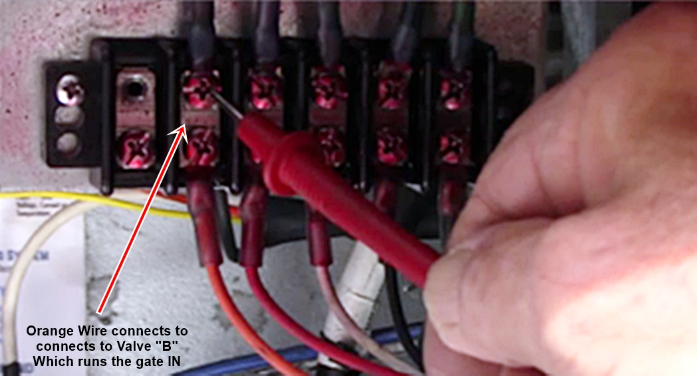
Symptom: Gate runs up, out, down but not in.
1). Check for 12V at the orange wire on the terminal strip. If you have 12V check coil on double stem.

Slide 17
Symptom: Gate runs up, out, down but not in.
2). If you have 12V check coil “B” on double stem. Easy way to check the coil is to swap coil “A” & “B”. Push down on the In & Out Switch if the gate runs in then the coil is bad. If the gate doesn’t move and you hit up on the In & Out Switch and it runs out then the Stem is bad.

Slide 18
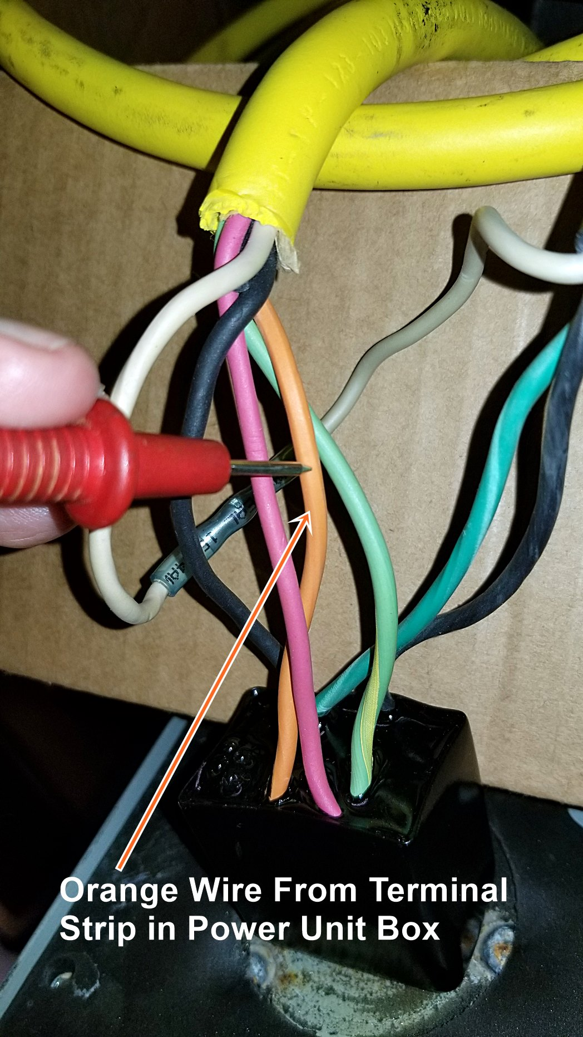
Symptom: Gate runs up, out, down but not in.
3). Check for 12V at the orange wire on the terminal strip. If you don’t have 12V at the orange wire on the terminal strip then do a continuity check on the orange wire from the terminal strip to the In and Out Switch in the In & Out Switch Box. If no Continuity change yellow wiring harness.

Slide 19
Symptom: Gate runs up, out, down but not in.
4). If all else checks out test the In & Out Switch for Operation. Disconnect the Red and Green wires at the In & Out Switch check continuity by pushing the switch down. If no continuity change switch.

Slide 20
Symptom: Gate runs in, out, down but not up.
1). Check for 12V at the Black wire on the terminal strip when pushing up on the Up & Down Switch. If you don’t have 12V check continuity at the switches.

Slide 21
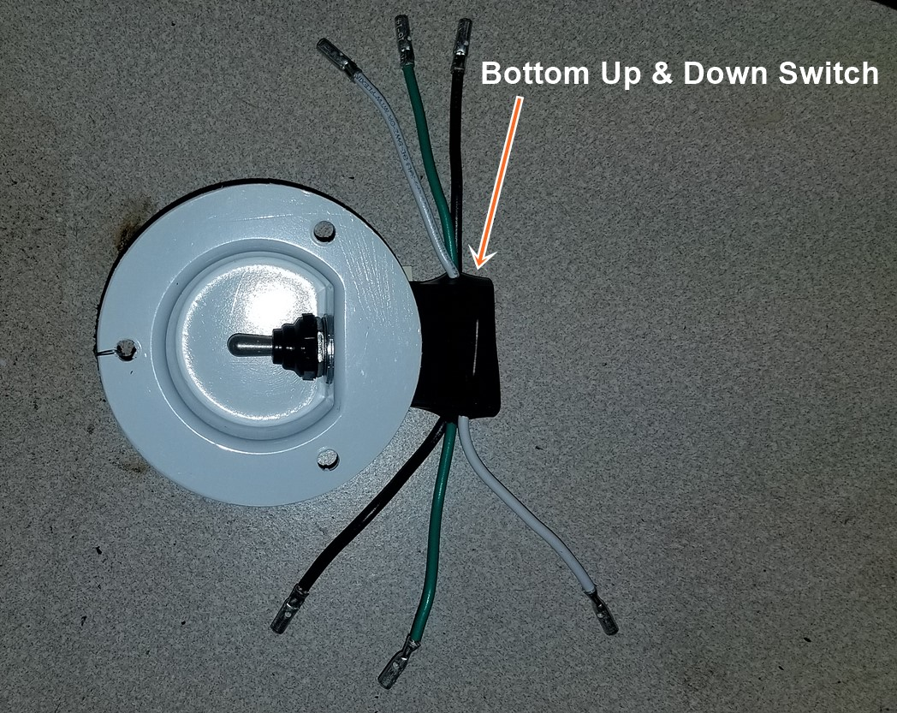
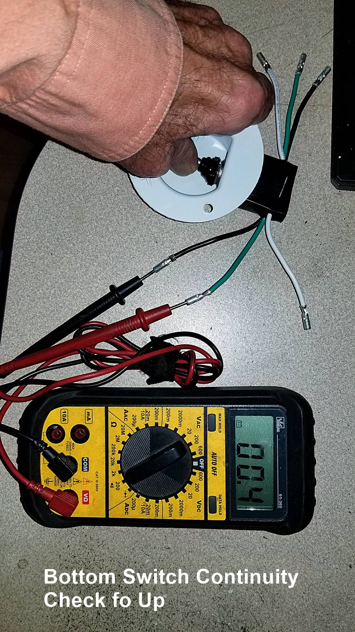
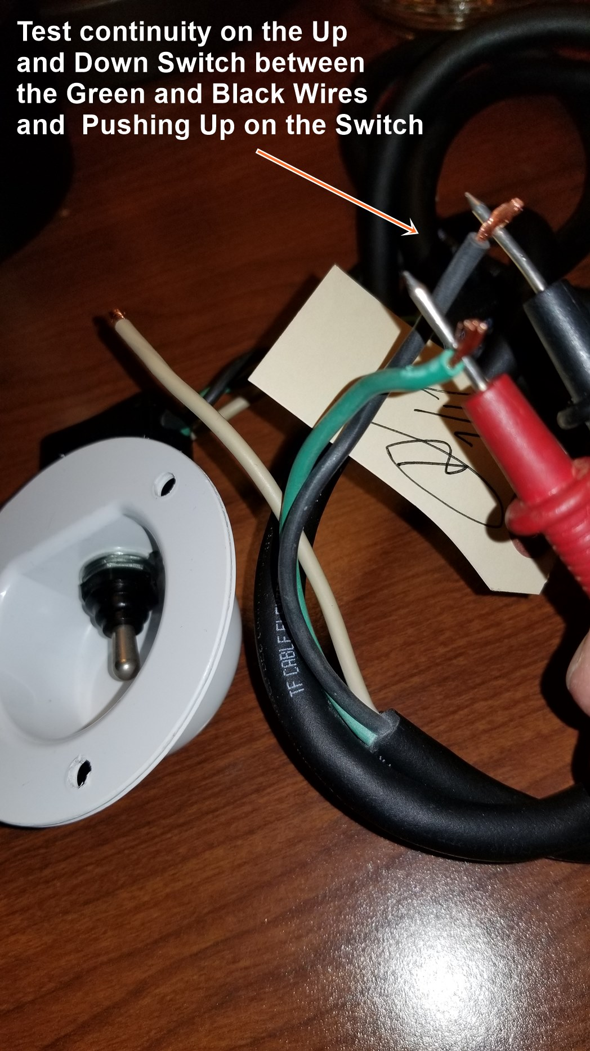
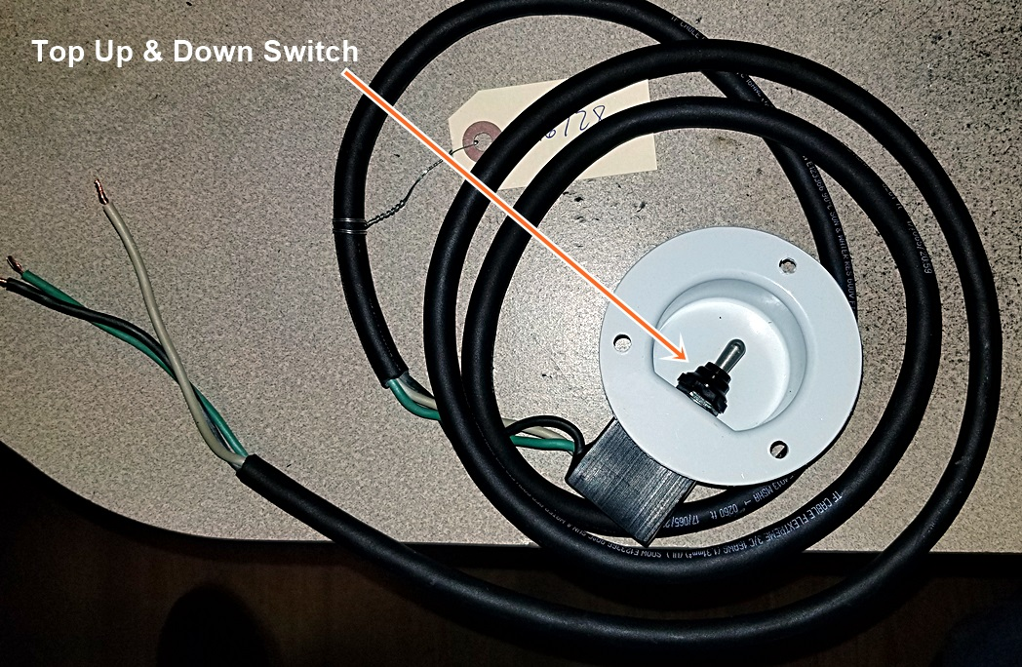
Symptom: Gate runs in, out, up but not up.
2). Test the Up & Down Switches for Continuity. Disconnect the Black and Green wires on the Up & Down Switches check continuity by pushing the switch up. If no continuity change switch.

Slide 22
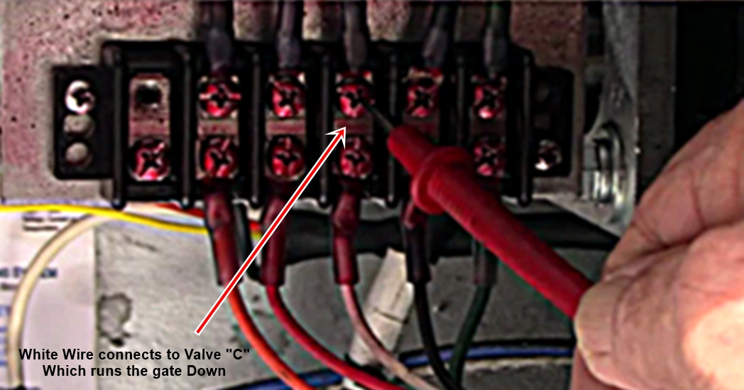
Symptom: Gate runs in, out, up but not down.
1). Check for 12V at the White wire on the terminal strip when pushing down on the Up & Down Switch. If you don’t have 12V check continuity of the Yellow Wiring Harness.

Slide 23
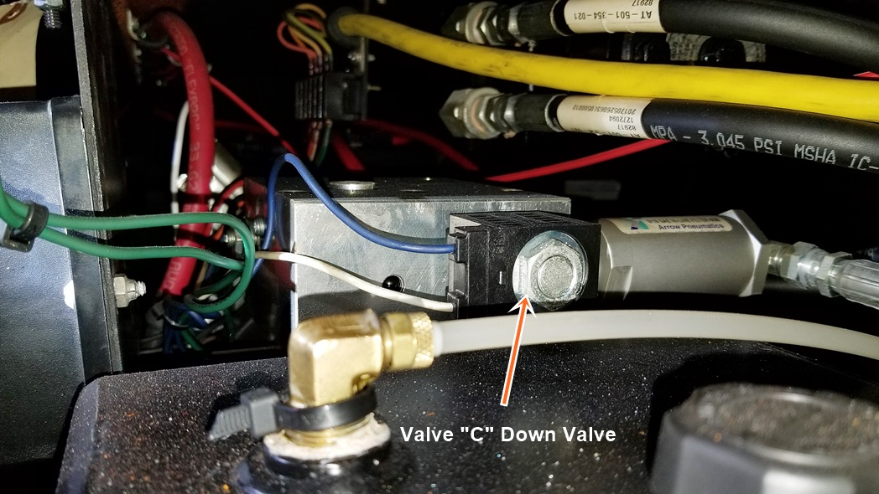
Symptom: Gate runs in, out, up but not down.
2). If you have voltage to the white wire at the terminal strip Check Valve “C” Coil and Stem for proper operation. Use a screwdriver ¼” away from valve nut push down on the Up & Down Switch if the screwdriver is pulled to the nut hard the coil is good. Change the Valve Stem

Slide 24
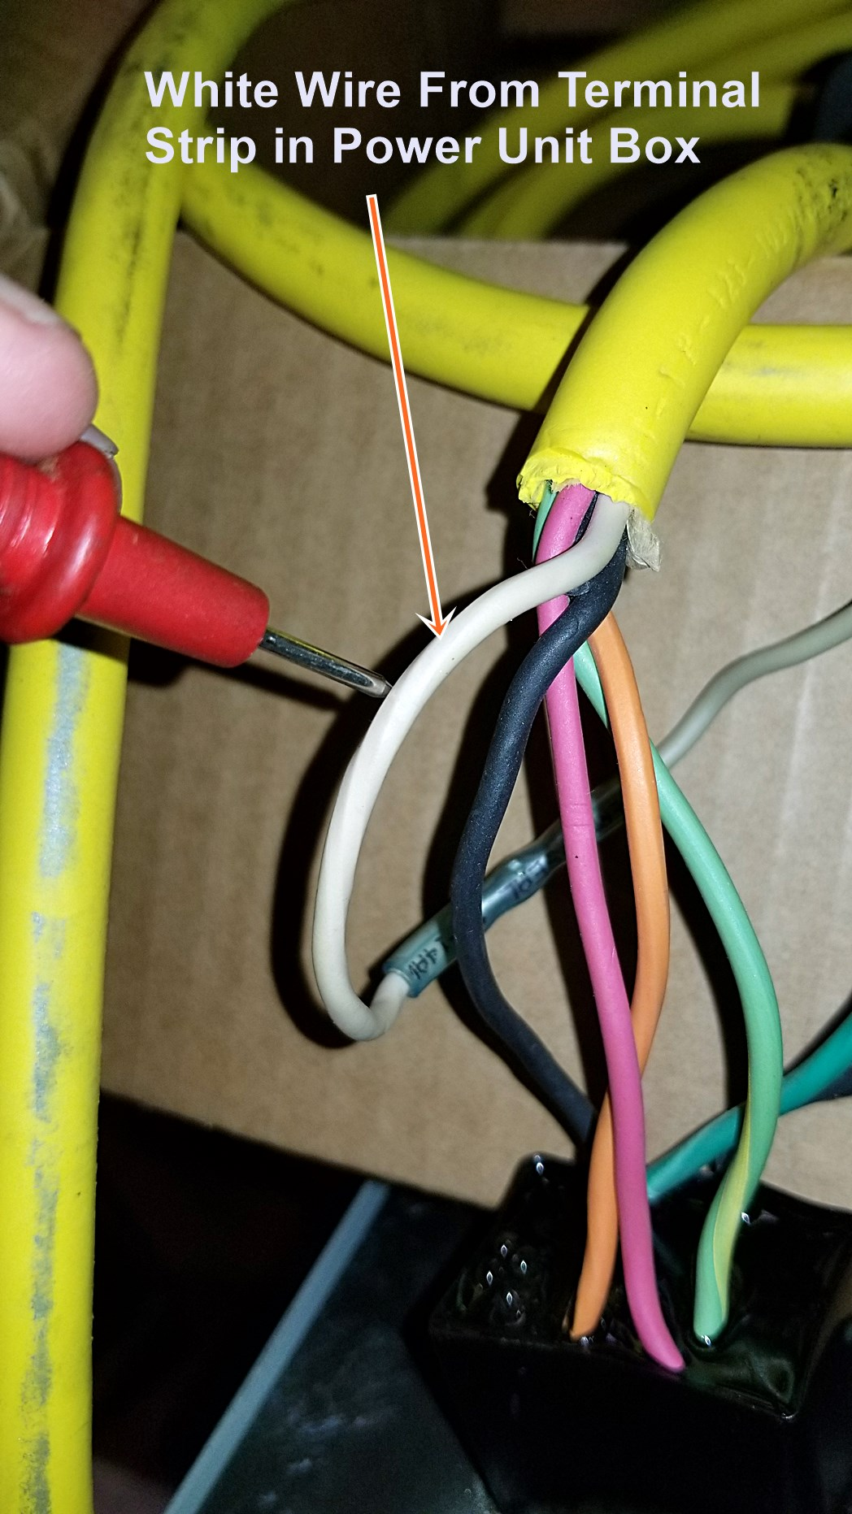
Symptom: Gate runs in, out, up but not down.
3). If you have continuity at the Yellow Wiring Harness check Up & Down Switches for continuity.

Slide 25
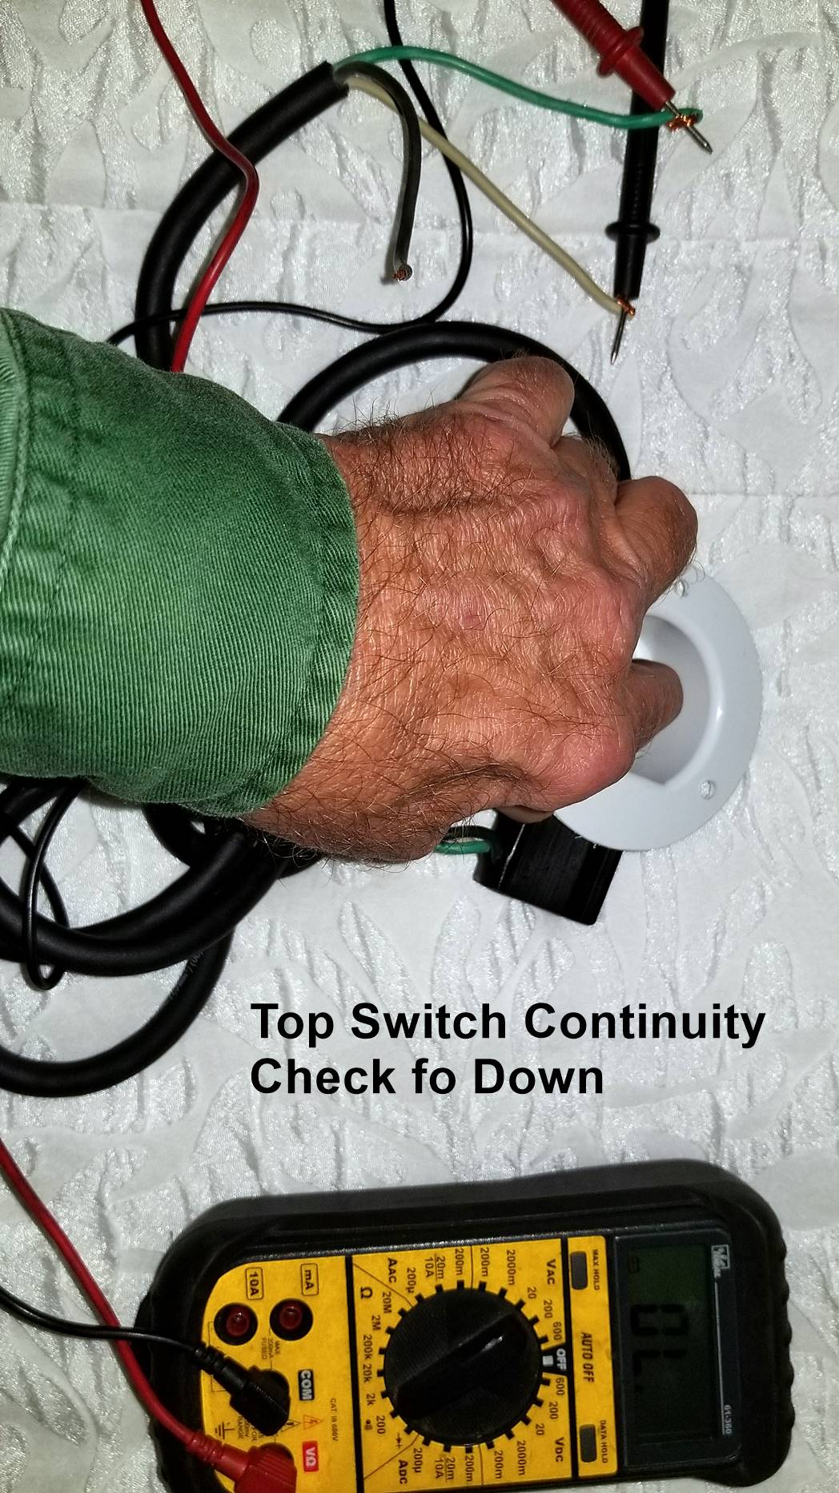
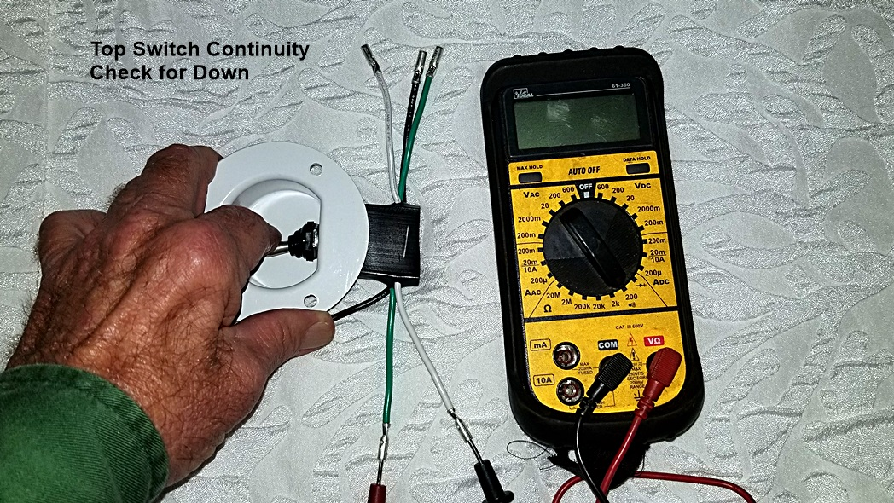
Symptom: Gate runs in, out, up but not down.
4). If you don’t have voltage Up & Down Switches for Operation. Disconnect the White and Green wires on the Up & Down Switches check continuity by pushing the switch down. If no continuity change switch.

Slide 26
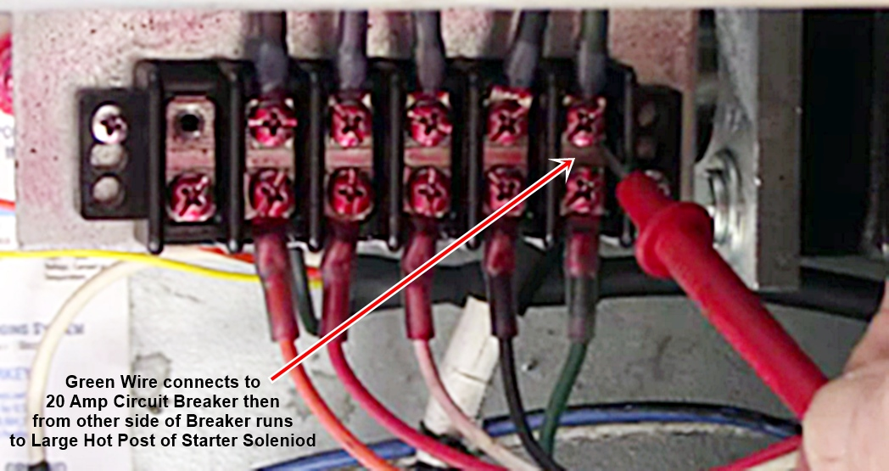
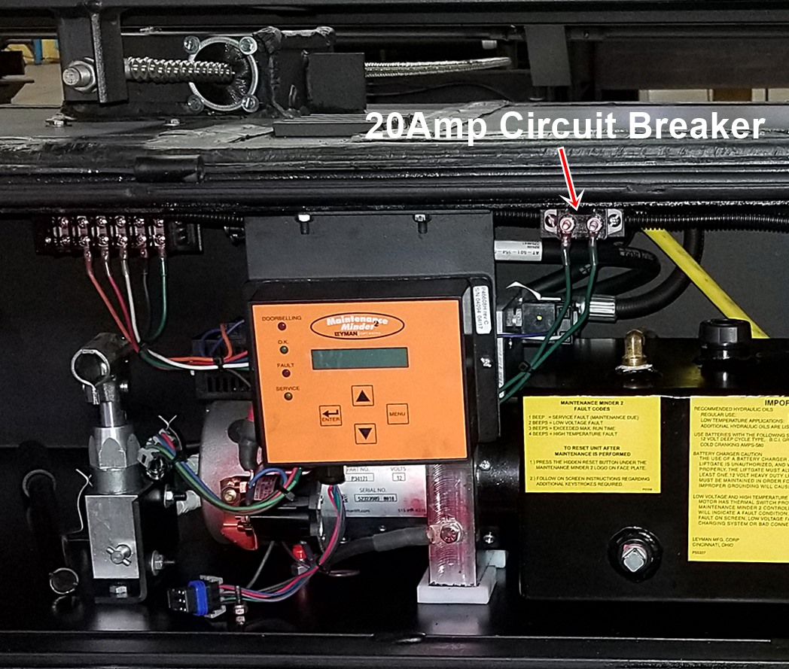

Symptom: Gate does not run Up, Down, In, or Out Motor not running
1). Check for power on the terminal strip on the green wire. If you have no power check 20 Amp circuit breaker continuity to make sure the circuit breaker isn’t bad.

Slide 27
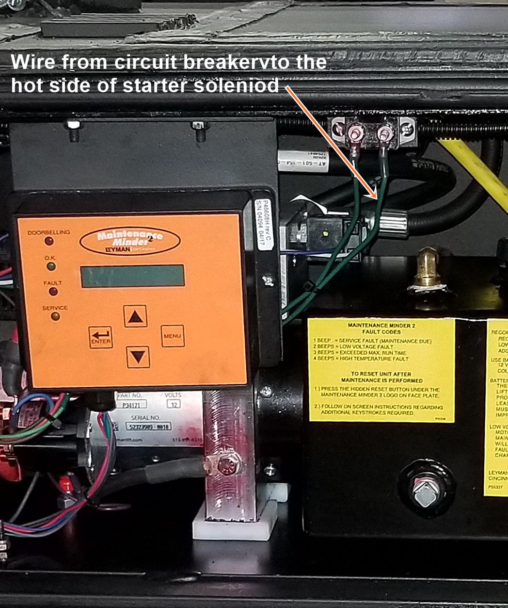
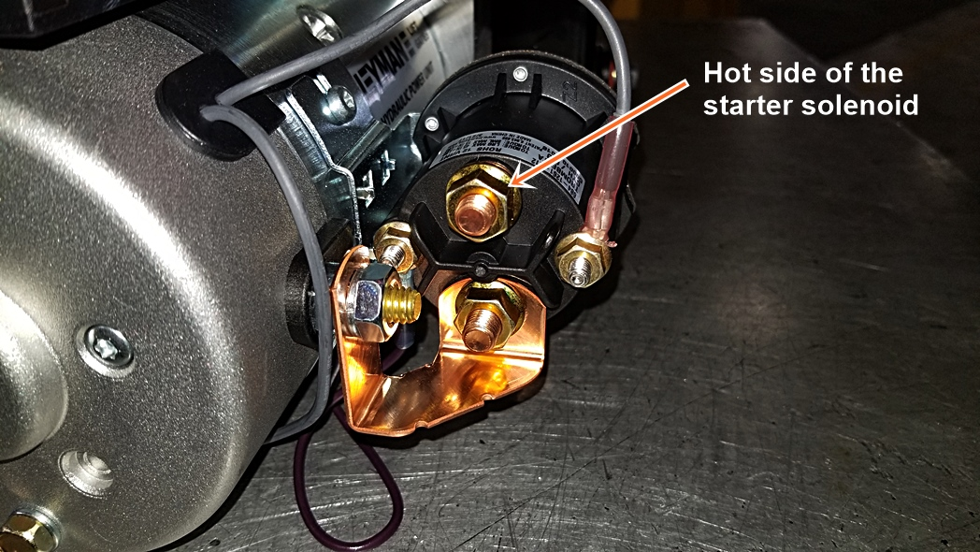
Symptom: Gate does not run Up, Down, In, or Out Motor not running
2). If the circuit breaker checks good then check the wire and connections from the circuit breaker to the hot side of the starter solenoid. If wire and connections are good, check continuity on the green wire in the yellow wiring harness from the terminal strip to the In & Out Switch Box.

Slide 28
Symptom: Gate does not run Up, Down, In, or Out Motor not running
3). If the circuit breaker checks good then check the wire and connections from the circuit breaker to the hot side of the starter solenoid. If wire and connections are good, check continuity on the green wire in the yellow wiring harness from the terminal strip to the In & Out Switch Box.

Slide 29
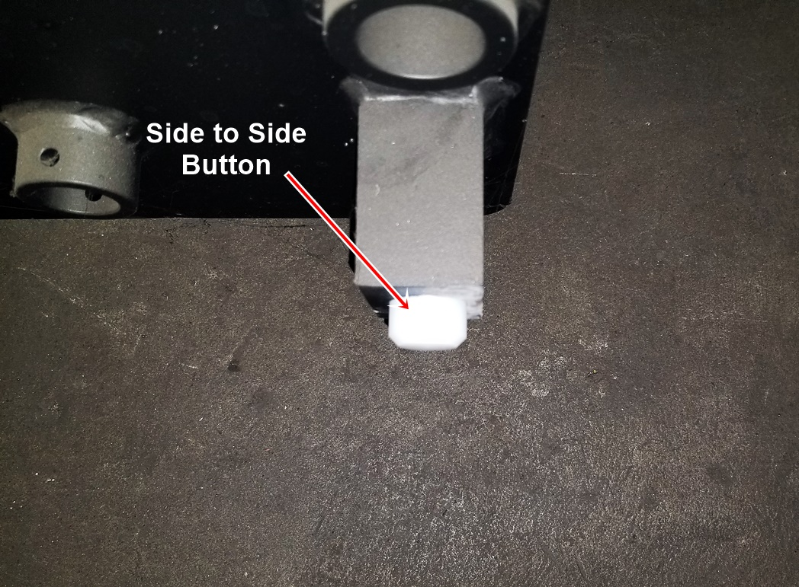
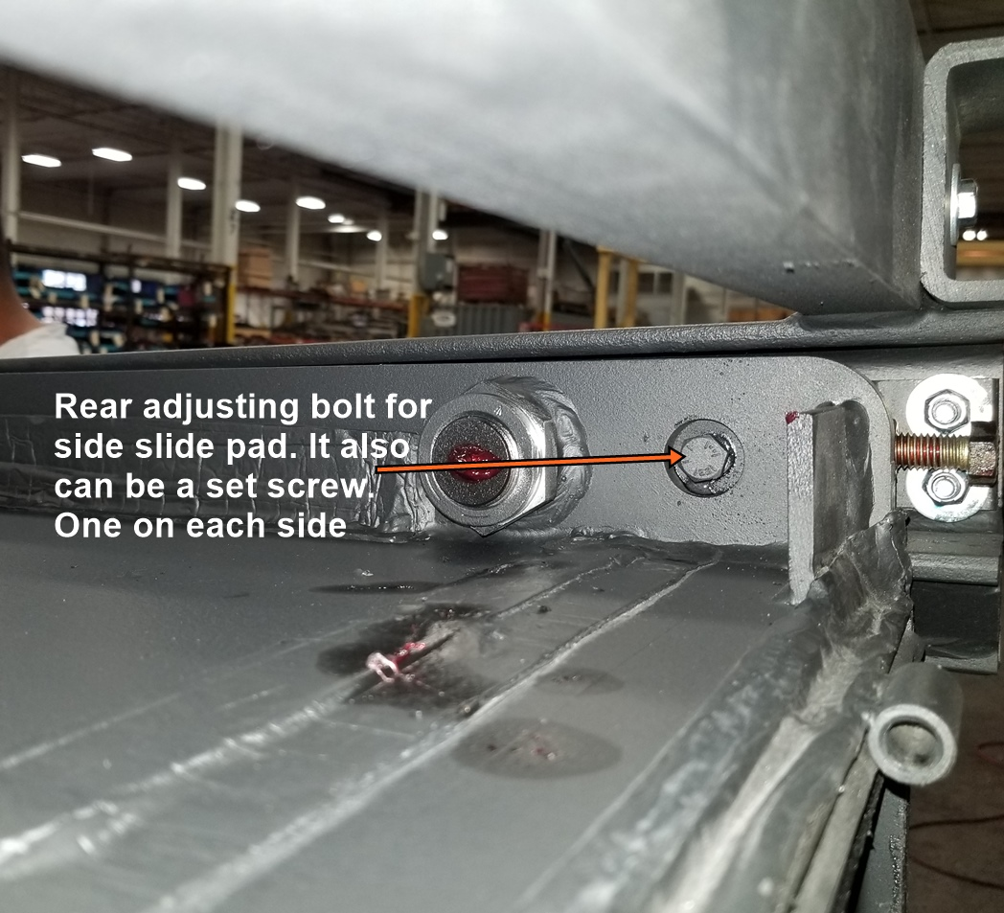
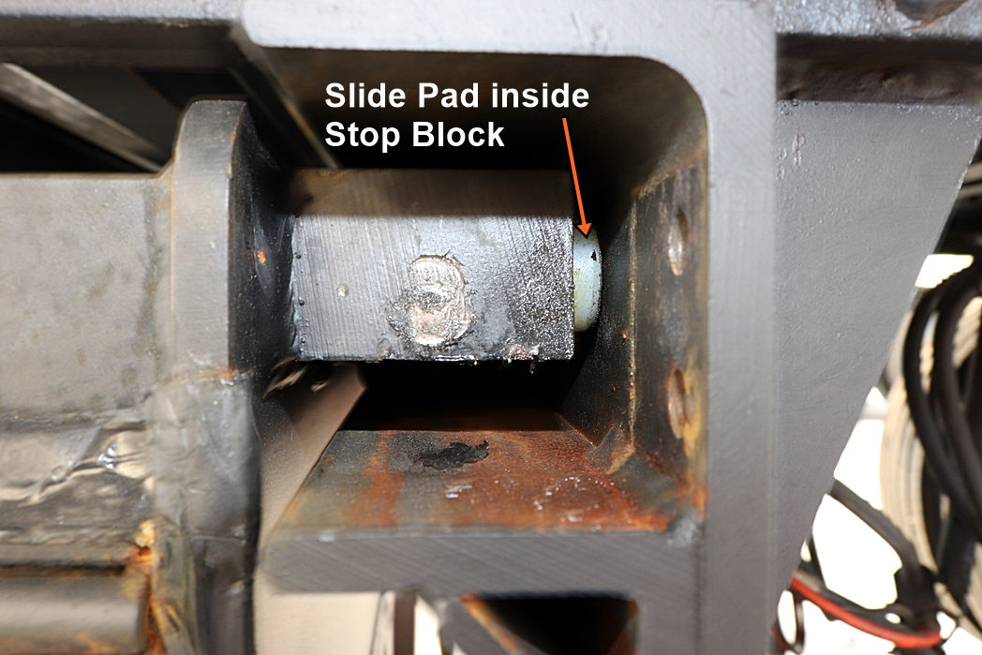
Symptom: Gate in & out moves side to side when running in & out.
1). You need to adjust the side to side skid pads on the gate. There are four, two in the front two in the back. Run gate all the way out to adjust the front skid pads and then all the way in to adjust the rear Side pads. Adjust the pads up against the inside of the track then back off 1 turn.

Slide 30
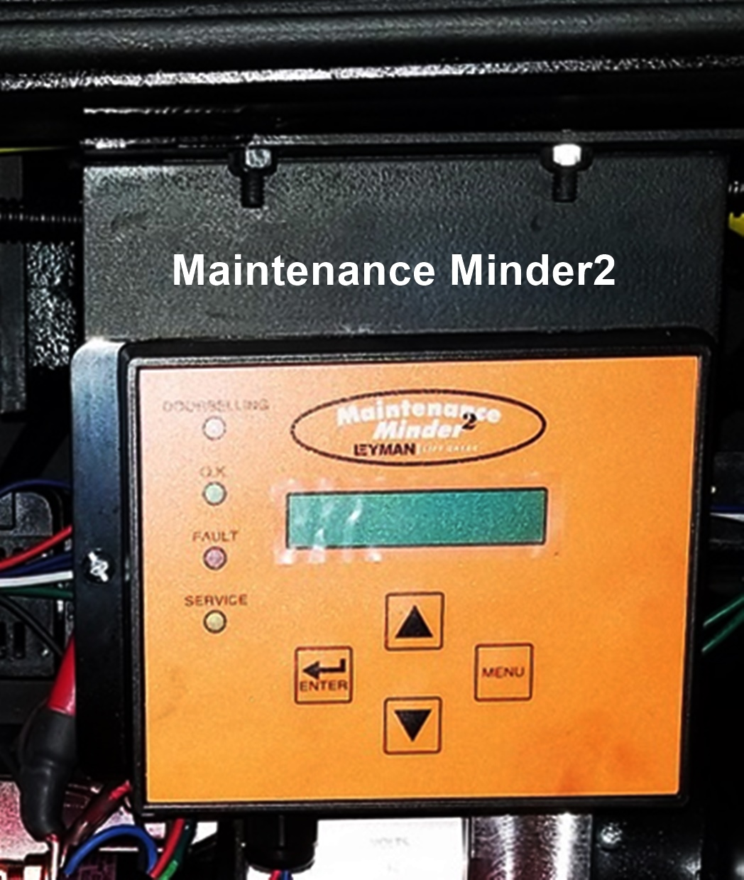
Symptom: Maintenance Minder² Faults.
1). There are four faults that will cause the MM2 to beep. Three will shut the gate down.

Slide 31
Symptom: Maintenance Minder² Faults.
2). Service Faults. This is an alert that lets you know it is time to do a PM on the lift gate. It will beep once every time there is a lift past 3000. It WILL NOT stop the operation of the lift gate.

Slide 32
Symptom: Maintenance Minder² Faults.
2). Low Voltage Faults. This is an alert that lets you know that the voltage of the batteries have gotten below 10 Volts. If this happens it WILL shut the motor off until the batteries are above 10 volts then it will automatically reset and allow the gate to run.

Slide 33
Symptom: Maintenance Minder² Faults.
3). High Temperature Faults. If the motor internally reaches 232 degrees the Thermistor will open and shut the motor down preventing the lift gate from running. Once the Motor cools the Thermistor automatically resets allowing the gate to run again.

Slide 34
Symptom: Maintenance Minder² Faults.
4). Max Run Time. The gate can only run for 3 minutes 30 seconds. If it continues past that the Maintenance Minder² will cut the voltage to the starter solenoid. If the starter welds itself shut the gate will continue the run.

Slide 35
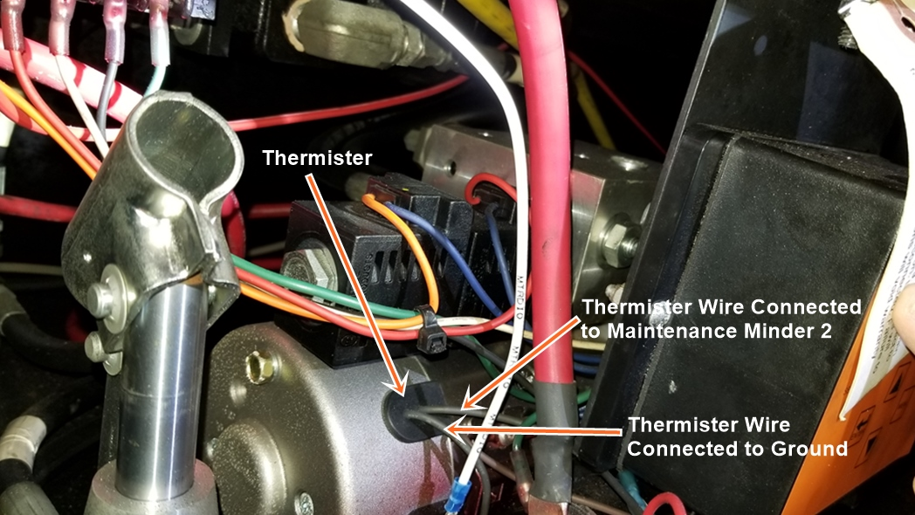
Symptom: Maintenance Minder² Faults.
3). High Temperature Faults. Please note the High Temperature Fault looks for ground if the ground wire on the thermistor is bad you will get a High Temperature Fault.

